Slide 1

WEATHER APP
-A Project by KRISHNA KUMARI CHINNI

Slide 2
TOPICS I HAVE USED……
HTML tags like head,title,buttons,etc.
CSS basic tags like style,etc.
Java Script concepts of basic html like basic functions creation.

Slide 3
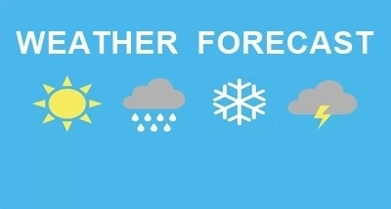

Slide 4
INTRODUCTION
In my project I am going to show the weather conditions in different states by using my Weather App Application.
My typing the respective state in my given app Application,it shows the date,day,time and temperature at that Position.
People can easily know the climatic conditions through my project very effectively in an easy manner.
Weather App helps the present to plan their respective ideology,trips according to their will by knowing the climatic conditions towards them in an easy manner.

Slide 5
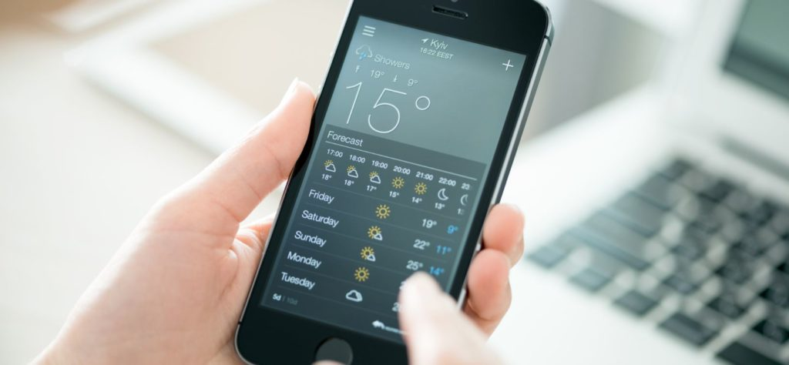

Slide 6
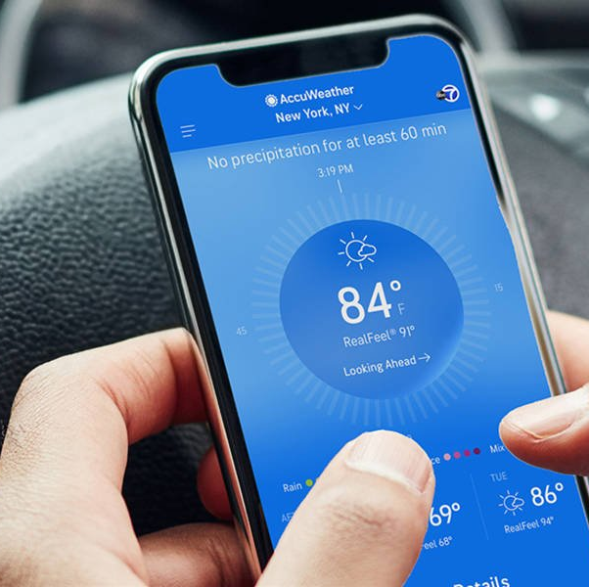
WORKING OF MY PROJECT……..
A variety of widgets with information about the real situation outside the window, images of your city, calendar, and so on; the temperature and precipitation data are displayed in the Android status bar, so the user always sees them, even when other applications are open.

Slide 7
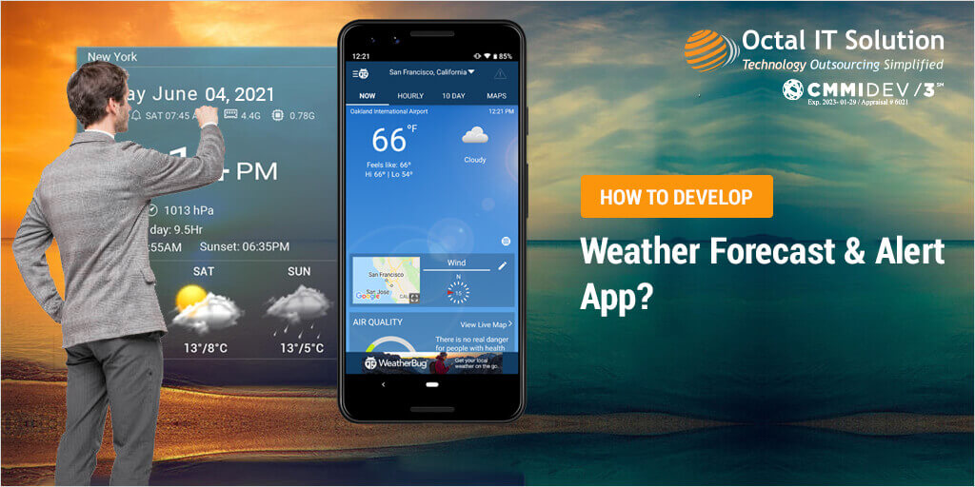

Slide 8
Sample code of my Project…
!DOCTYPE html><html lang="en"><head> <meta charset="UTF-8"> <meta http-equiv="X-UA-Compatible" content="IE=edge"> <meta name="viewport" content="width=device-width, initial-scale=1.0"> <title>Document</title> <style> *{ background-image: url('https://www.pnas.org/content/118/9/e2101899118/F1.large.jpg'); } #d2{ width: 450px; height: 370px; margin-left: 500px; margin-top: 150px; text-align: center; color: white; } #d3{ color:white; border: none; } #d1{ height: 30px; border: none; color: white; } </style></head><body> <div id="d2" style="background-image:url('https://cdn3.vectorstock.com/i/thumb-large/59/17/different-images-of-the-four-seaons-vector-2735917.jpg');"> <h1>check weather report</h1> <input id="d3" type="text" placeholder="enter the city name" style="height: 30px;"><br><br> <button id="d1" onclick="fun()">search</button> </div> </body><script> function fun() { var str=document.getElementById('d3').value; if(str=="amravati") { window.location="https://www.accuweather.com/en/in/amravati/189309/current-weather/189309" } else if(str=="hyderabad") { window.location="https://www.accuweather.com/en/in/hyderabad/202190/weather-forecast/202190" } else if(str=="dispur") { window.location="https://www.accuweather.com/en/in/dispur/3592996/weather-forecast/3592996" } else if(str=="itanagar") { window.location="https://www.accuweather.com/en/in/itanagar/357099/weather-forecast/357099" } else if(str=="patna") { window.location="https://www.accuweather.com/en/in/patna/202349/weather-forecast/202349" } else if(str=="raipur") { window.location="https://www.accuweather.com/en/in/raipur/187458/weather-forecast/187458" } else if(str=="panaji") { window.location="https://www.accuweather.com/en/in/panaji/188095/weather-forecast/188095" } else if(str=="gandhinagar") { window.location="https://www.accuweather.com/en/in/gandhinagar/188134/weather-forecast/188134" } else if(str=="chandigarh") { window.location="https://www.accuweather.com/en/in/chandigarh/202350/weather-forecast/202350" } else if(str=="shimla") { window.location="https://www.accuweather.com/en/in/shimla/188519/weather-forecast/188519" } else if(str=="ranchi") { window.location="https://www.accuweather.com/en/in/ranchi/203541/weather-forecast/203541" } else if(str=="bengaluru") { window.location="https://www.accuweather.com/en/in/bengaluru/204108/current-weather/204108" } else if(str=="thiruvananthapuram") { window.location="https://www.accuweather.com/en/in/thiruvananthapuram/204287/weather-forecast/204287" } else if(str=="bhopal") { window.location="https://www.accuweather.com/en/in/bhopal/204408/current-weather/204408" } else if(str=="mumbai") { window.location="https://www.accuweather.com/en/in/mumbai/204842/current-weather/204842" } else if(str=="imphal") { window.location="https://www.accuweather.com/en/in/imphal/189551/weather-forecast/189551" } else if(str=="shillong") { window.location="https://www.accuweather.com/en/in/shillong/189555/current-weather/189555" } else if(str=="a

Slide 9
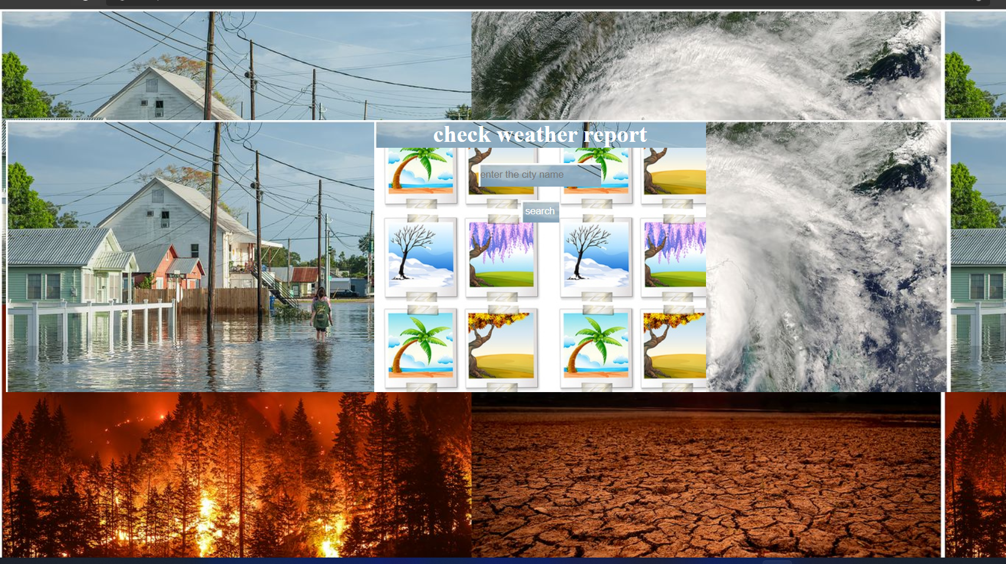

Slide 10
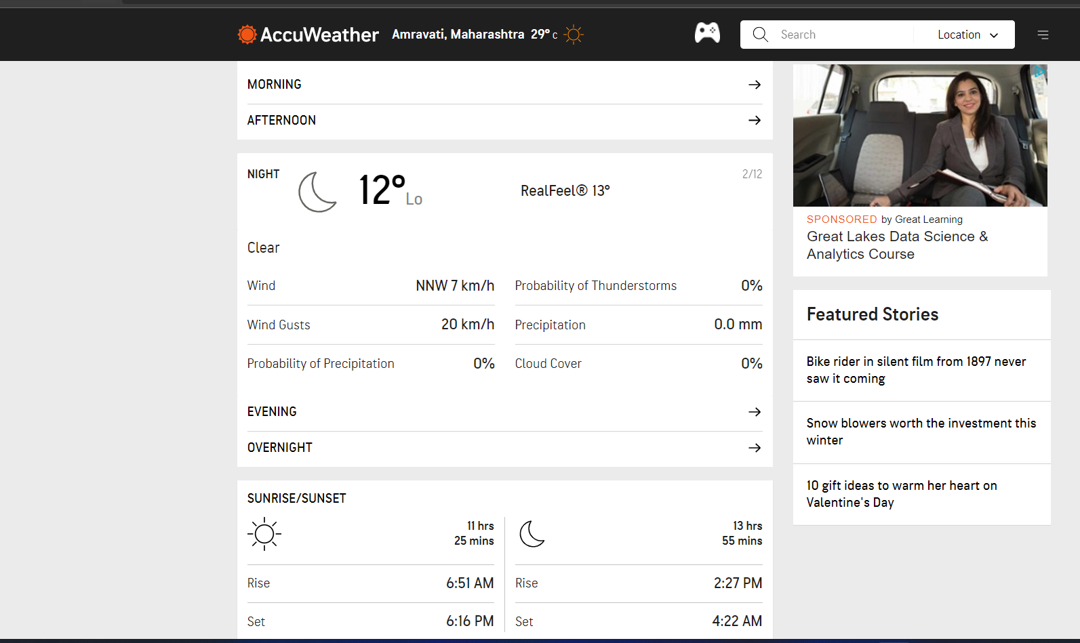

Slide 11
CONCLUSION…..
->Weather is something everybody deals with,and accurate data of it like what is coming can help users to make inform decisions.
->With Weather Apps for IOS and Android,people can exactly know when to expect change in the weather conditions.
->Weather Apps can give urgent alerts too.
->Instant information availability .Improved Weather forecast.Easy flow of Information.
->Widget Support.

Slide 12
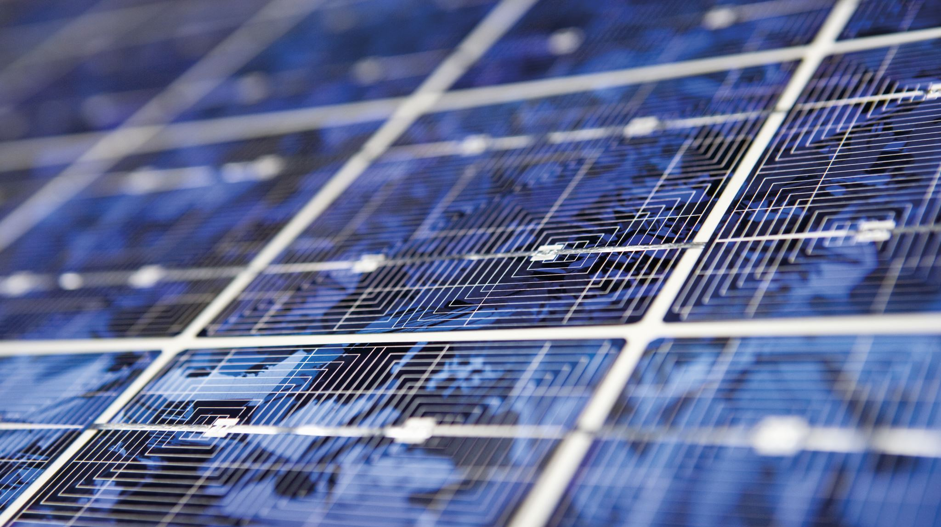
REFERENCES…..
HTML,CSS AND JAVASCRIPT Concepts from Jon Duckett
jQuery Cookbook
Web Development with jQuery by Richard York.
Utube Channel References.

Slide 13


